Slide 1
Excelerate User Engagement & Opportunity Sign Up
Team 2A
Presentation Video

Slide 2
Team Members
Mariam Ayman Helmy: Gp Dentist with healthcare informatics and data automation experience.
Uto Onuoha: Postgraduate with Data Analysis entry level experience.
Olaiya Anuolo Queensley: Research Assistant and Data Analyst.
Bolarinwa Sakirah Oluwakemi: Medical laboratory scientist.
Yara Ashraf Radwan: Pharmaceutical Engineer with data analysis experience.
Olamide Kolawole: Data Analyst

Slide 3
Introduction

Slide 4
Purpose
Key Questions
The Dashboard provides insights into user engagement and opportunity sign-ups to help understand user behavior and identify growth opportunities.
1- How engaged are users with the platform?
2- What are the trends in opportunity sign-ups?
3- Which user segments show the highest engagement?

Slide 5
Dashboard Overview

Slide 6
Key Metrics
Number of Users:
- Total Users: 27.56K
- Number of Learners: 11.16K
- Total Reward Amount: 3M
Gender Distribution:
- Female Users: 6,910
- Male Users: 11.03K

Slide 7
User Sign-Up Locations
Top 10 countries:
India, Nigeria, United States, Pakistan, Ghana, Egypt, Vietnam, and others.
Us Cities:
St Louis: 912
Chicago: 375
Naperville: 31
Others listed

Slide 8
Opportunity Categories and Rewards
Popular Opportunities by Gender
Internship: Highest rewards and skill points.
Course: Moderate rewards.
Competition, Engagement, Event: Lower rewards and skill points.
Data Visualization: Most popular overall, especially among females.
Project Management and Digital Marketing: Also popular.
Health Care Management, Innovation & Entrepreneurship: Notable mentions.

Slide 9
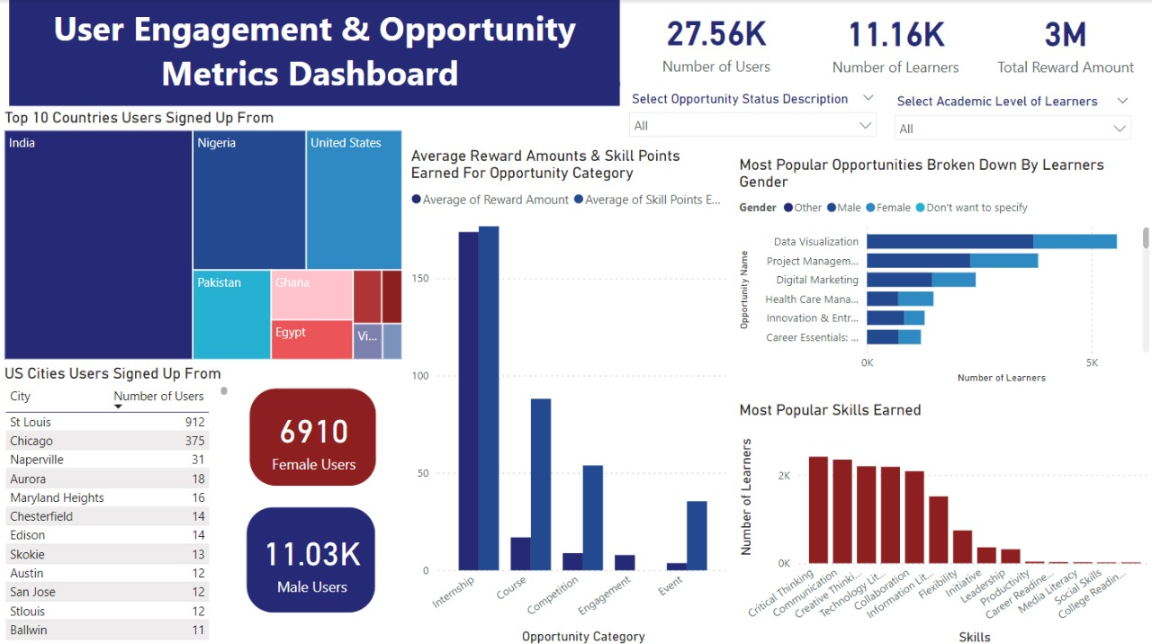
Skills Earned
Critical Thinking, Executive Thinking, Technical Literacy, Communication, and others.

Slide 10
Challenges Faced
while working with the datasets and solutions
implemented to address those challenges

Slide 11
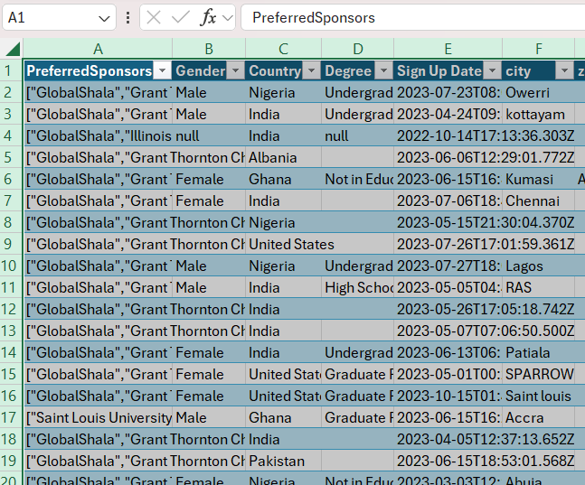
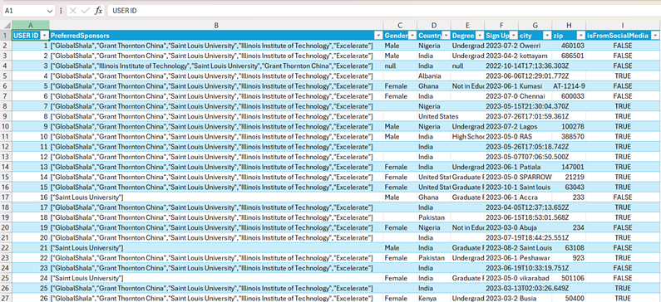
1- Primary Key
The lack of a unique identifier for each row in the User Data dataset.
USER ID column was added to the dataset to act as a primary key for each row in the dataset.

Slide 12
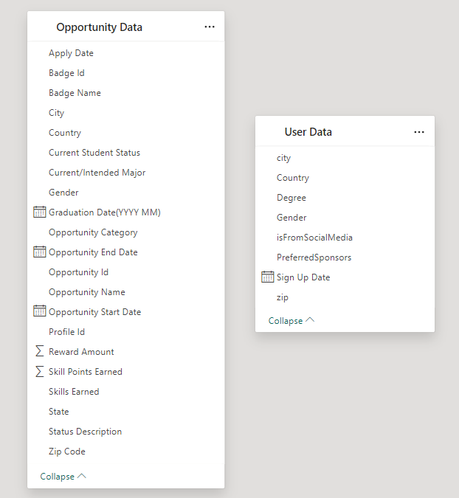
2- Foreign Key
The lack of foreign key to connect both datasets together.
It was eventually decided not to add any as the required user demographics (gender, geographic info, academic level..) are also present in the Opportunity Sign Up dataset.

Slide 13
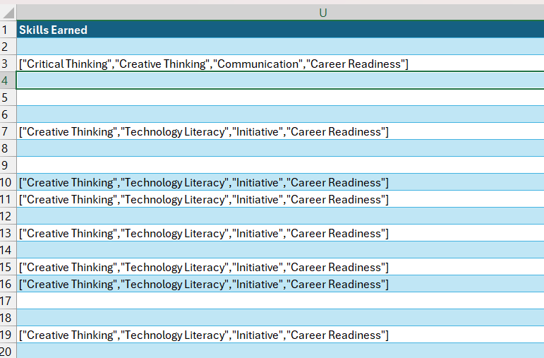
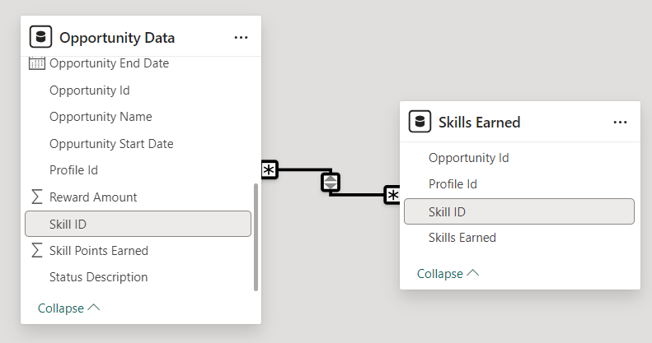
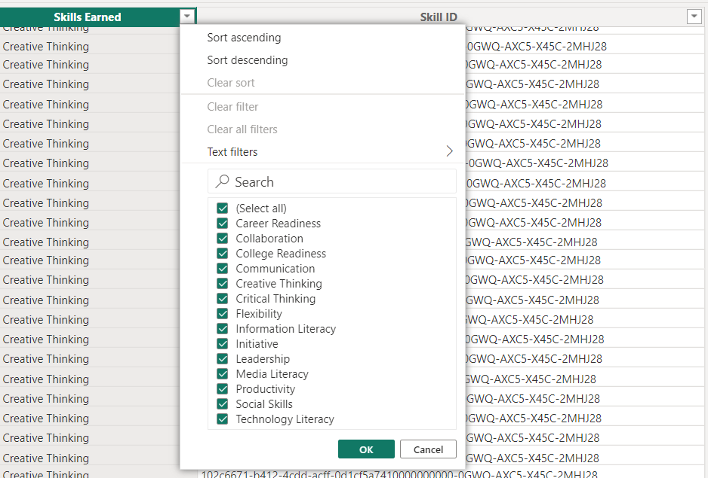
3- SKills Earned
Skills Earned cells in Opportunity Data contained multiple values which made it difficult to analyze.
Normalization of Skills Earned into a new table using both Profile ID and Opportunity ID as a composite foreign key to link them to their original table.

Slide 14
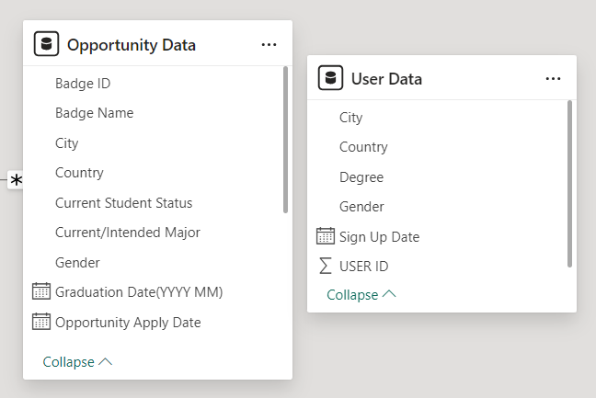
4- Geographic Information
Only the City and Country columns were kept to be used as geographic identifiers while the rest (zip code, state..) were excluded for easier data processing and analysis.

Slide 15
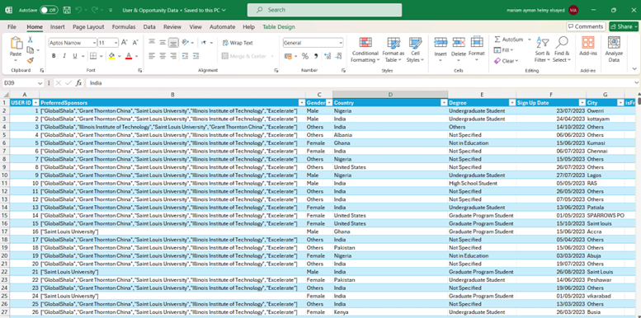
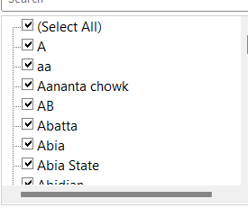
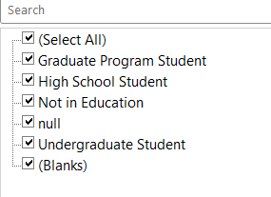
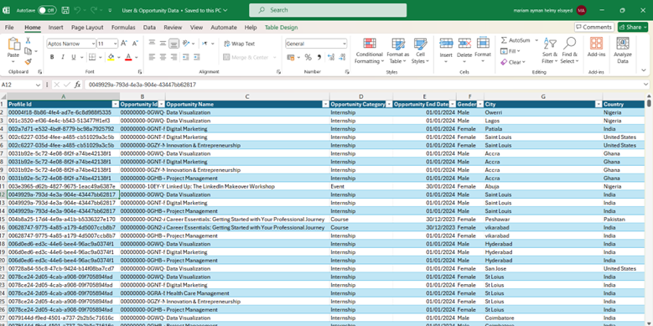
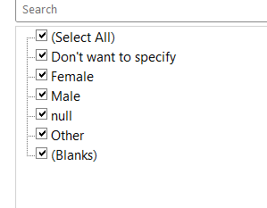
5- Missing & Unclear Data
Categorizing the null and invalid values columns into “others”/”not specified” to avoid deleting the entire rows and maintain the results of analysis and visualizations.

Slide 16
User Data Insights

Slide 17
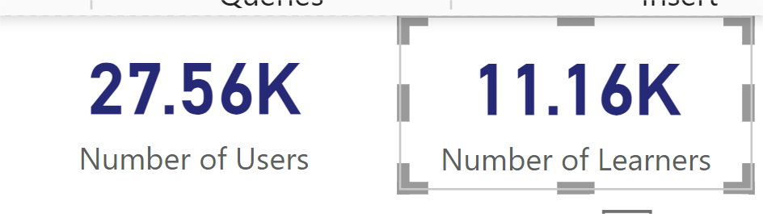
User Data Insights
Insights from our User Data Visualizations showed that about 27000 individuals signed up on the platform and about 11000 individuals signed up for opportunities.

Slide 18
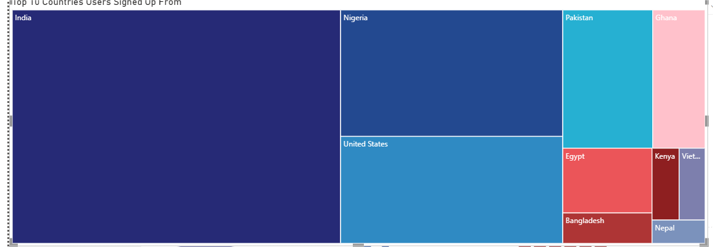
Top 10 Countries Users Signed up from
The top 10 countries users signed up from were: India, Nigeria, Pakistan,United States, Ghana, Egypt, Bangladesh, Kenya, Nepal and Vietnam.

Slide 19
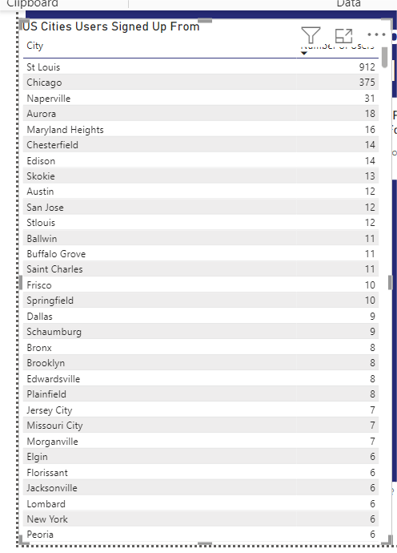
Cities in the US learners signed up from
Some of the cities in the US learners signed up from includes the following: St Louis, Chicago, Naperville,Aurora,Maryland heights, Chesterfield,Edison,Skokie, Austin,San Jose, Springfield and many others .
However, majority of the learners were from St Louis and Chicago with a total number of 912 and 375 learners respectively.

Slide 20
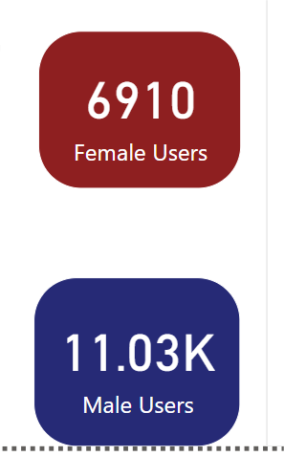
User Data according to Gender
The User Data shows 6910 users were registered as females and about 11000 users were found to be males indicating that we had more males than females.

Slide 21
MOST POPULAR SKILLS

Slide 22
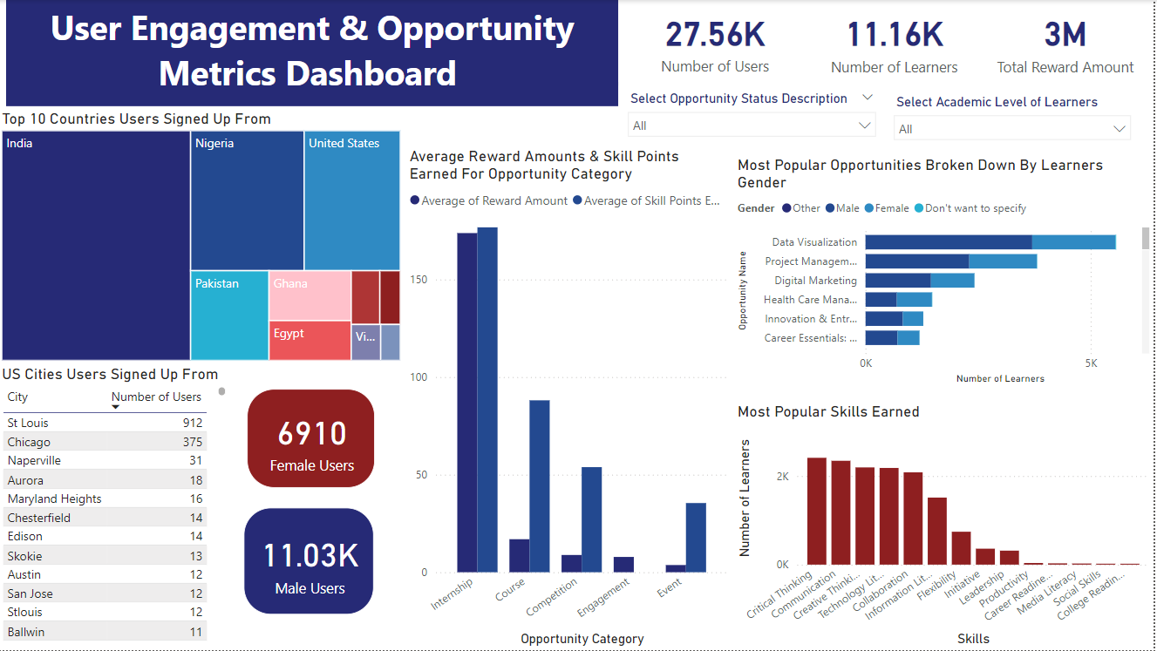
Most popular earned skill
We have over 10 skills that was earned by
different individuals. Critical thinking is
the most popular and widely earned skills,
Which as total number of 2412 Learners.
However, it's very essential for problem-
Solving and decision making.

Slide 23

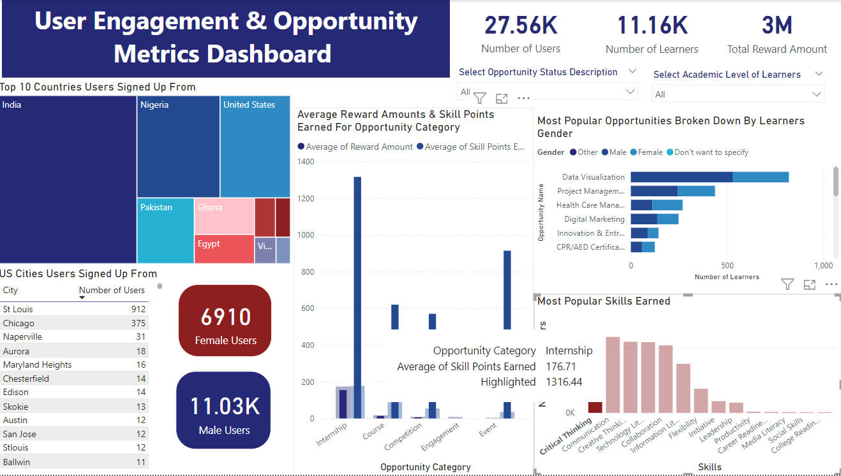
Differences in the distributions
This also shows the numbers and distributions
change through the other opportunity name and
category to show the results for this particular
skill that us highlighted. This is applicable to
all selected skills.

Slide 24
REWARDS INSIGHTS

Slide 25


Reward Visualization Insights
The total reward amount was 2,7258,60.
Total number of learners was 111,60.
Reward amount per learner was 244.

Slide 26
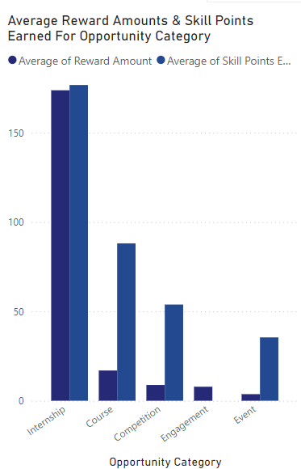
Average Reward Amounts & Skill Points Earned
The opportunity with the highest average amount of Reward and Skill points earned was Internship. The reward amount and skill point earned were almost at par with each other.
Course had little reward amount but high skill points earned. Same with Competition and event.
Engagement had no skill points earned.

Slide 27
MOST POPULAR OPPORTUNITY

Slide 28
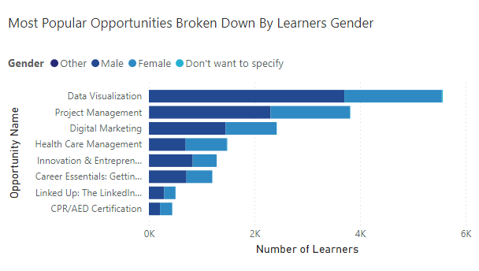
Most Popular Opportunities Broken Down By Learners Gender
The chart illustrated the most popular
Opportunities users signed up for, with Data
Visualization being the highest.
Males have the highest proportion of users that signed up for most of the opportunities.

Slide 29
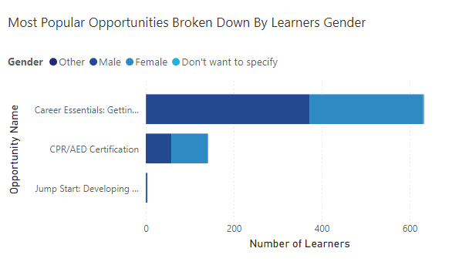
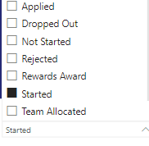
Career essentials has the highest number of users
that actually signed up and started the course.

Slide 30
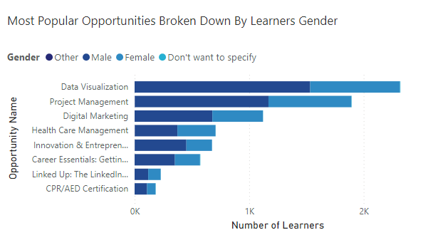
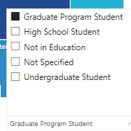
Most Popular Opportunities Based on Academics Level of Learners
Data visualization is the most popular
opportunity among graduate users,
undergraduates students and those that
are not in school.

Slide 31
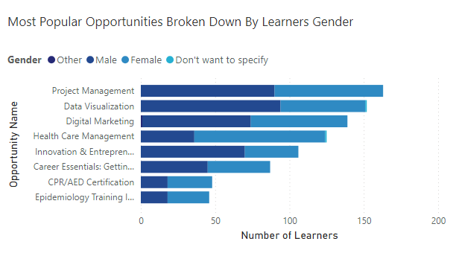
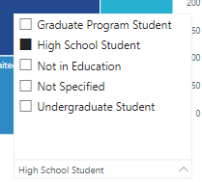
Higher school students signed up majorly for
Project management as compared to other
academic levels.

Slide 32
Thank You!

